Slide 1

Center for Accelerating Materials Modeling
Mark Hagen⁽¹⁾ & Thomas Proffen⁽¹⁾ ⁽¹⁾ Neutron Data Analysis & Visualization Division
Galen Shipman⁽²⁾ & Bobby Sumpter^{(2,3)} ⁽²⁾ Computational Science & Mathematics Division ⁽³⁾ Center for Nanophase Materials Science
Olivier Delaire⁽⁴⁾ ⁽⁴⁾ Materials Science and Technology Division

Slide 2
Outline
Background context
Spallation Neutron Source
Analysis, validation & prediction (CAMM)
CAMM seed project
CAMM framework
Test & user projects
Advanced projects
Interfacing with other initiatives
Summary

Slide 3
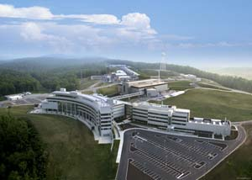
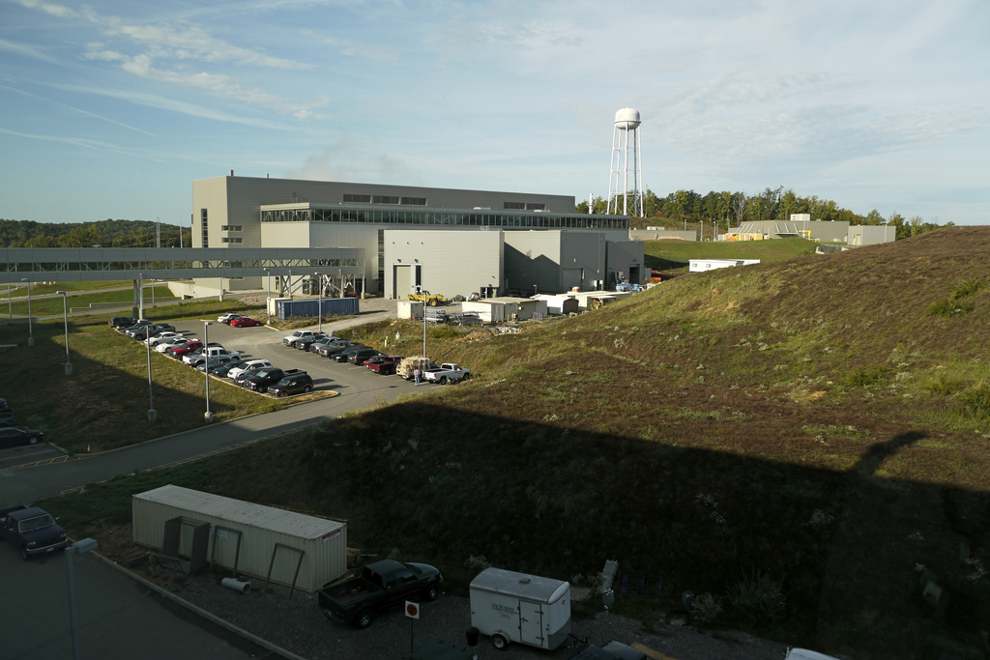
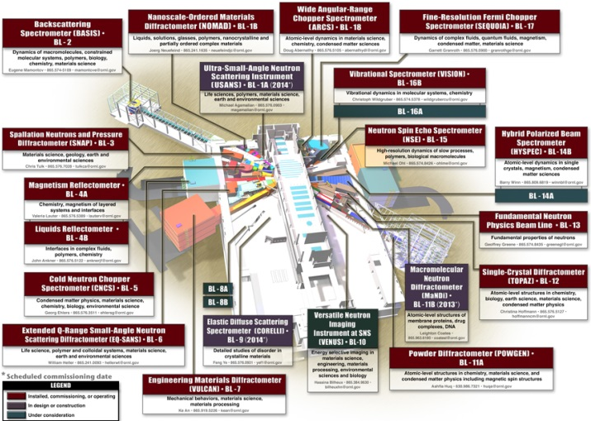
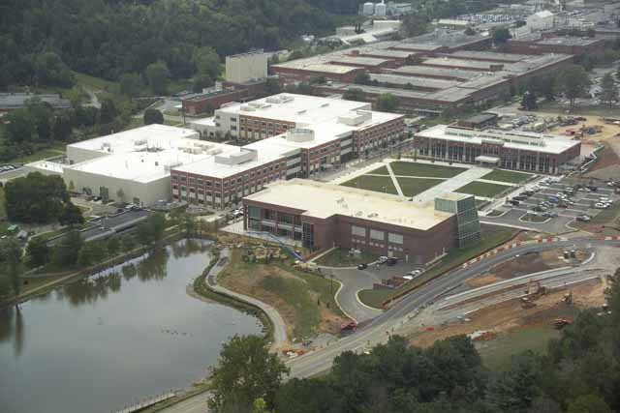
Spallation Neutron Source
DoE’s user facilities – APS, ALS, NSLS, LCLS, SNS & HFIR
~ 500 user projects (beam allocations) per year
Wide range of materials studied – biological, polymers, metals, insulators, superconductors, magnetic, ferroelectric, fluids,… etc.
Techniques – diffraction/structure, (crystal, disordered), inelastic (phonons, spin waves, diffusion), small angle scattering & reflectometry (large scale structures)
All data is stored in HDF5 files, catalogued, reduced (MANTID)
Started in 2011 – ADARA – stream data to supercomputer center, data reduction “on-the fly” (on-going)

Slide 4
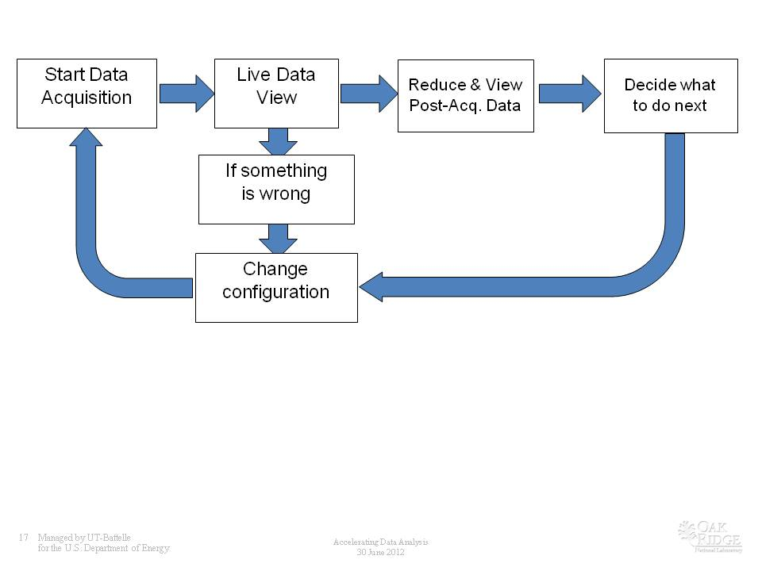
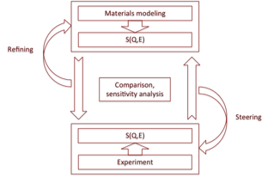
Analysis, validation & prediction
Shortening the time from discovery to application….
From the Facility Perspective – October 2011 BES/ASCR Workshop Bring data analysis (modeling & simulation) into the experimental chain…
From the Predictive Modeling Perspective – Have reliable models to predict (simulate) the properties of models
To have reliable models they need to be validated and refined against experimental data.
CAMM – Center for Accelerating Materials Modeling from SNS Data
Create the software to refine/validate materials modeling (simulation) results against neutron scattering data from the SNS… test and apply that software over a wide range of cases
Later development – available “on- the-fly” (near real time)
Predictive – use results to steer experiments to look for new phenomena

Slide 5
CAMM seed project
18 month seed – develop framework to refine MD force-fields against quasi-elastic & inelastic neutron scattering data → 9 months so far
Refinement: Initial estimate of parameters Compute theoretical prediction for expt. data Compare theory vs. expt. (sum of residuals squared) A strategy to predict new (better) parameters
Test & develop → “simple” test case → friendly users → more advanced cases
Force field parameters
MD Simulations
Trajectories for atoms
Calculate S(Q,t) + S(Q,E) Weighted Fourier Transform + Averaging
Predicted data
“Correct” for expt. effects
Use templates
for different MD codes
Write output files in HDF5 format
Scaling, background, resolution, detailed balance, multiple scattering, SE scattering, etc.

Slide 6
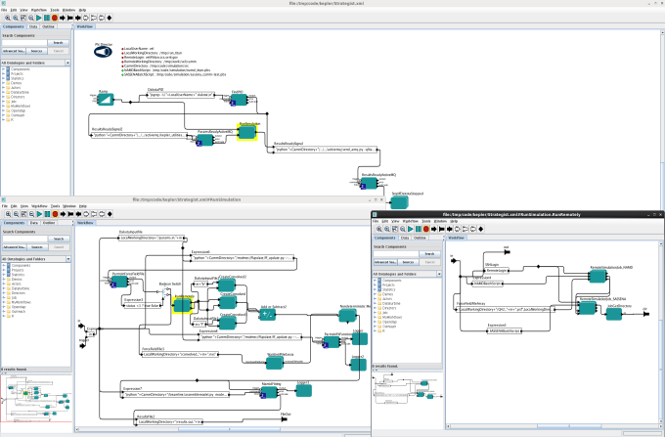
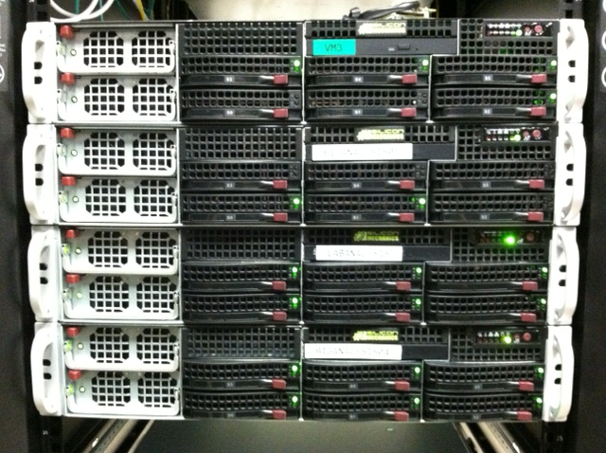
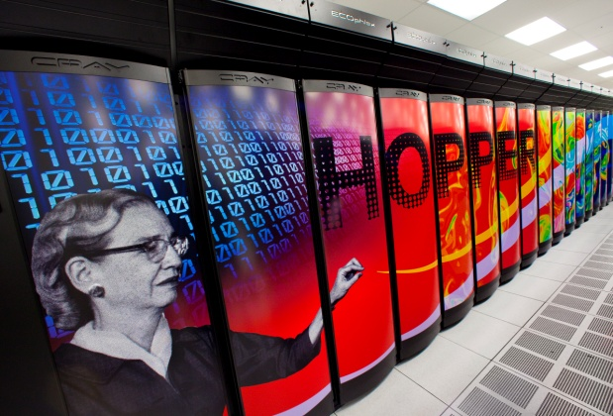
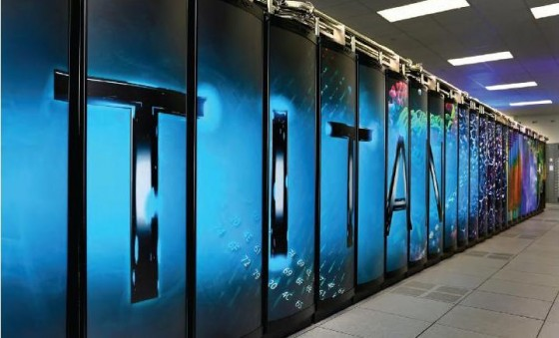
CAMM framework
DON’T RE-INVENT THE WHEEL….
Refinement: Initial estimate of parameters Compute theoretical prediction for expt. data Compare theory vs. expt. (sum of residuals squared) A strategy to predict new (better) parameters
ASCR: DAKOTA, Kepler, grid-ftp, Globus
SNS data infrastructure: Active MQ messages for status, HDF5 files w/ meta data → MANTID & catalogue simulations in ICAT
{ DAKOTA }
{ KEPLER }
Force field parameters
MD Simulations
Trajectories for atoms
Calculate S(Q,t) + S(Q,E) Weighted Fourier Transform + Averaging
Predicted data
“Correct” for expt. effects
camm-test.sns.gov
camm.ornl.gov
chadwick

Slide 7
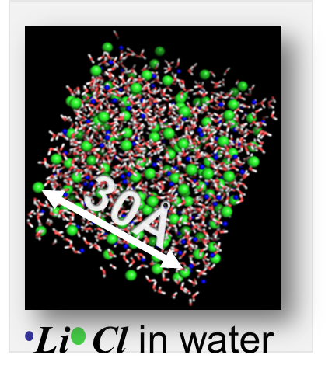
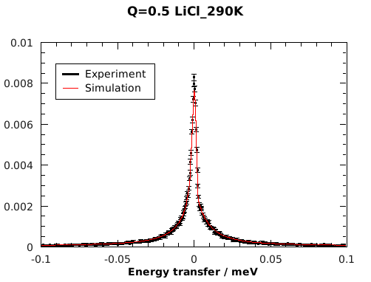
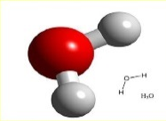
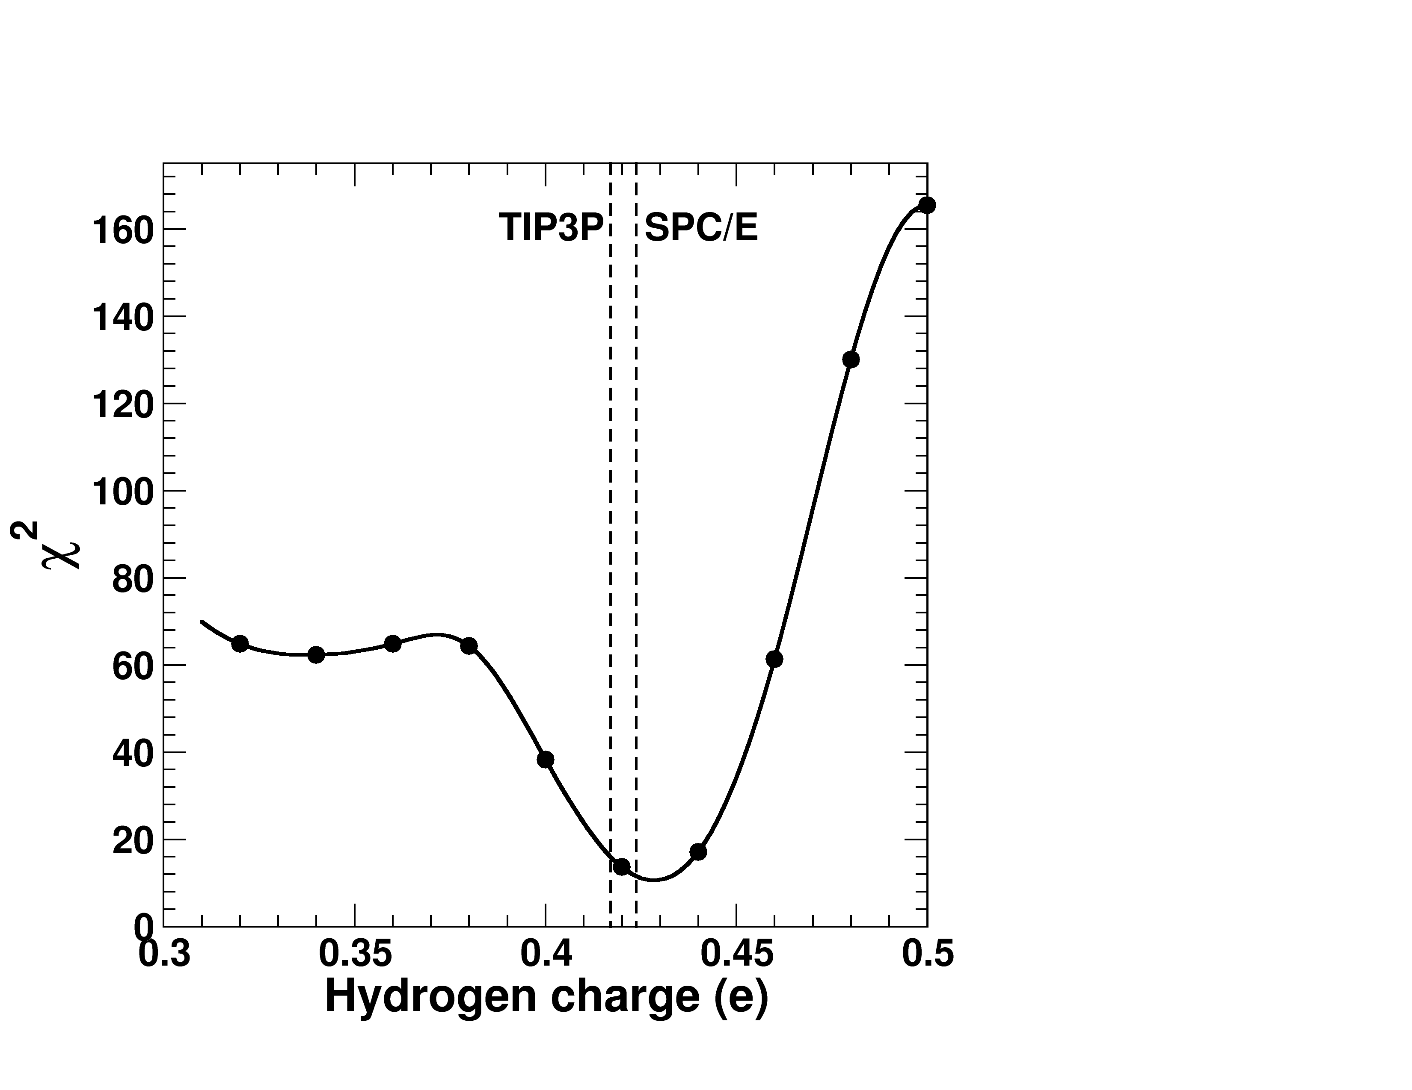
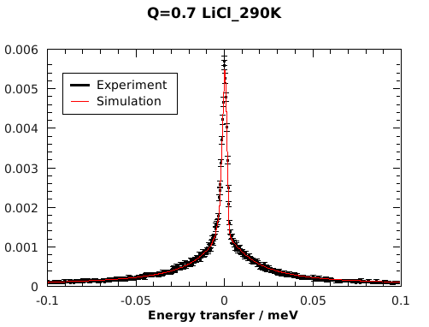
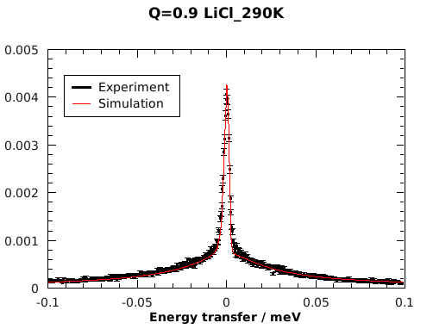
CAMM test – aqueous LiCl
Jose Borreguero & Eugene Mamontov
High concentrations of LiCl allow studies of bulk water dynamics under 200K. LiCl induces polarization of the water
NAMD simulations
Optimal Hq=0.431 , LiCl induces a polarization ~ 3% in p
Hq=0.417e (TIP3P)
Hq=0.424e (SPC/E)
-2∙Hq
Hq
Hq

Slide 8
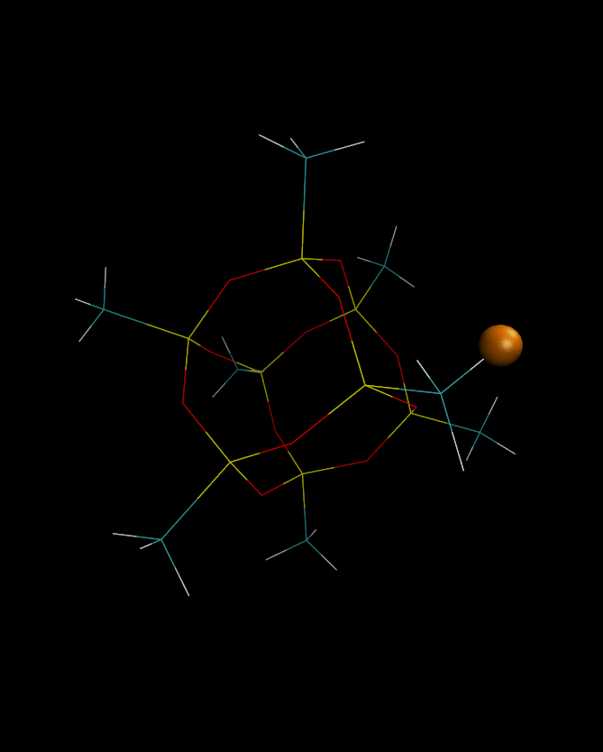
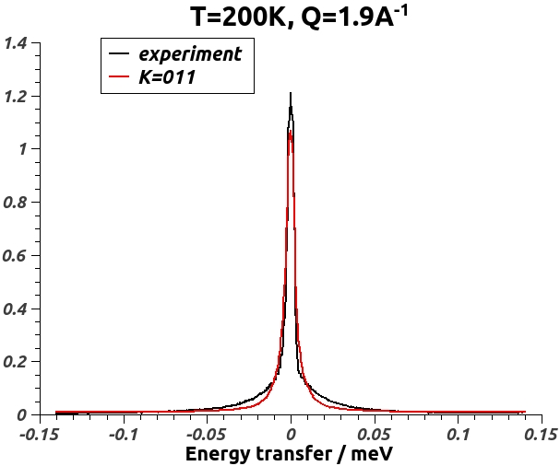
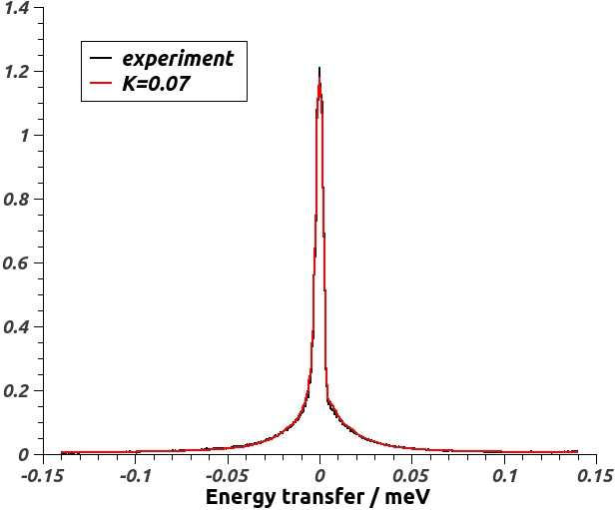
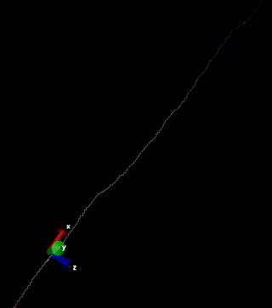
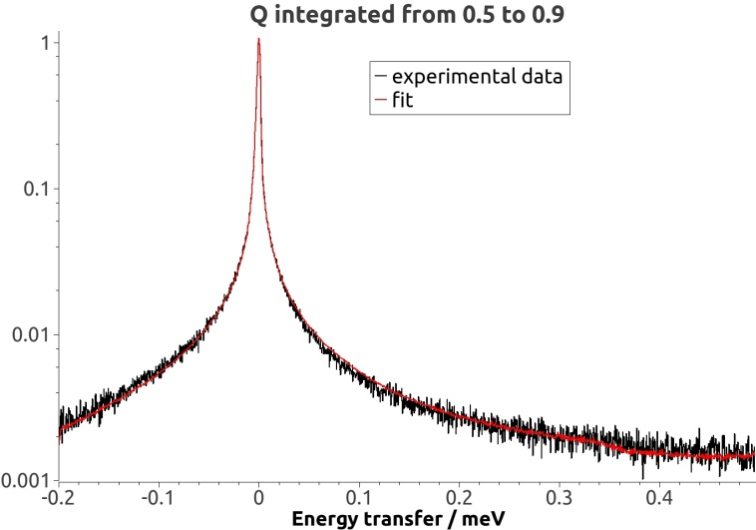
Testing with friendly users
Jose Borreguero
Mike Crawford (Dupont) & Niina Jalarvo (Julich) BASIS experiment / MD simulation studies of Methyl rotations in methyl-Polyhedral oligomeric silsesquioxanes (POSS) Optimization of dihedral potential governing the rotational jumps in methyl hydrogens Preliminary simulations indicate that the dihedral potential barrier must be decreased ~37% in order to match experimental data
Jonathan Nickels (UTK)
Complementary CNCS experiment / MD simulation studies of the Boson peak in Poly-L-Glutamic acid (polyE) homopolymers
The Boson peak is a collective excitation in the 2-5 meV range, often observed in soft-matter materials.
polyE displays a Boson peak that shifts in energy upon changes in the environment.
Quais-elastic data collected at CNCS beamline.
Andrew Stack (ORNL, CSD)
Complementary BASIS / MD simulation studies of water adsorbed onto nanoparticles of barite (BaSO₄)
Original
force-field
Optimized
force-field
One of the preparation steps in the simulation involves the collapse of the homopolymer chain from an initial stretched conformation

Slide 9
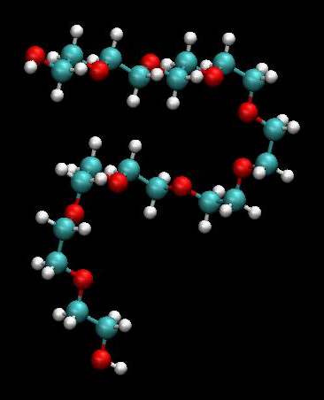
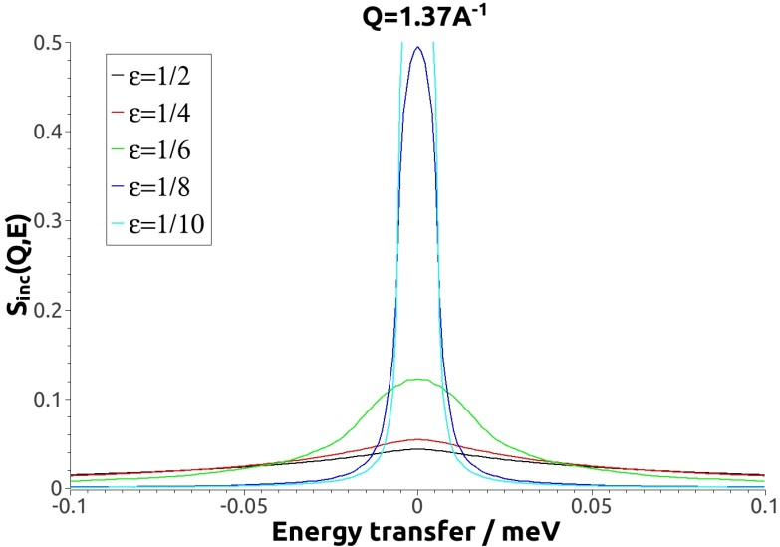
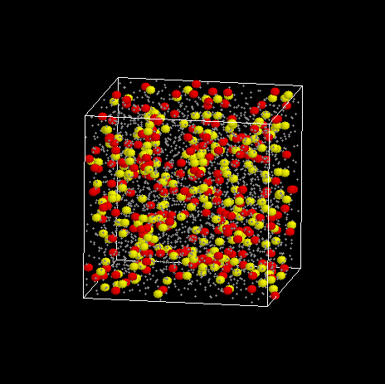
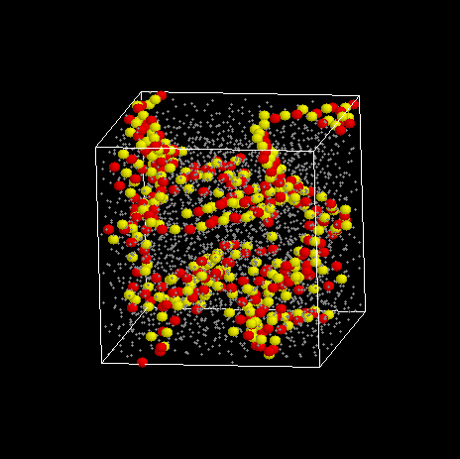
Coarse grained modeling of polymer electrolytes
Polyethylene Oxide -
Acrylic Acid (+ LiCl)
Bobby Sumpter & Monojoy Goswami
Previous simulations were atomistic, here we’d like to examine how far we can go with coarse-grained simulations
Modification of the S(Q,E) calculation to include b_{eff} F(Q) as the scattering factor for the “block”
Polymer electrolyte batteries have poor ionic conductivity so interested in simulating ionic hopping and comparing to quasi-elastic neutron scattering
Also doing full atom simulation for comparison
ξ_{Β} = 1/ε

Slide 10
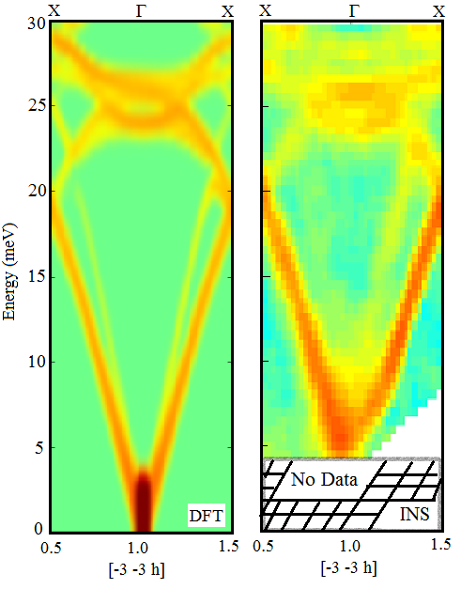
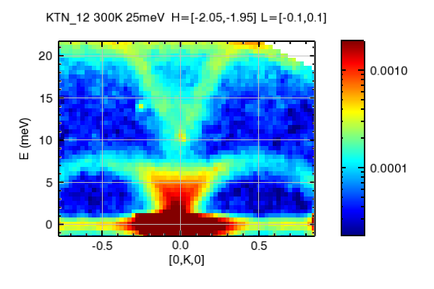
First-principles modeling of phonon spectra
Olivier Delaire & Jiawang Hong
Leverage first-principles simulations to simulate phonons in ferroelectrics and thermoelectrics.
Fitting of parameterized models to correct possible deficiencies of DFT.
Enable quantitative assessment of non-harmonic behavior in measured phonons.
Perform large-scale ab-initio molecular dynamics to capture phonon temperature dependence, and anharmonic effects (phonon scattering rates).
Within CAMM, provide expertise for modeling of phonon data in important energy materials.
FeSi, DFT
FeSi, SNS
K(Ta,Nb)O₃ phonon S(Q,E), HYSPEC at SNS

Slide 11
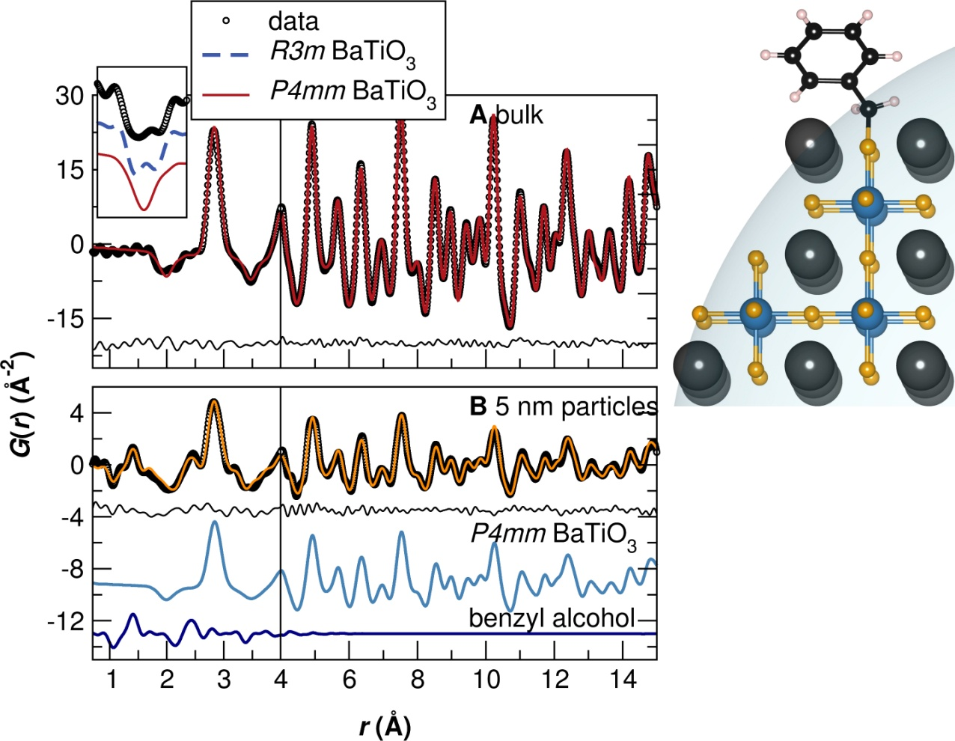
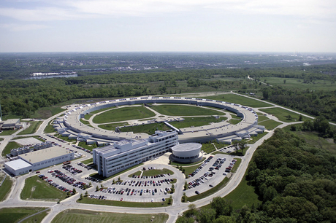
Interfacing with other initiatives
CAMM framework – how to “standardize” I/O for useful exchange of force fields etc.?
What other modeling & simulation codes/science areas should we integrate into the framework? (… should be measurable with neutrons)
Inclusion of other probes/techniques?
Data Pilot Project – APS/MSD/MCS & SNS – Advanced Structural Characterization Using Experimental Data from Multiple Facilities
Partnership proposals 11ID-B (APS) & NOMAD (SNS) – nanoscale disorder (PDF) Future: 11ID-D (APS) & Corelli (SNS) – single crystal diffuse scattering
Joint data catalogue, co-refinement software, user interface & single sign-on

Slide 12
Summary
Develop a framework to validate/refine MD force-fields against neutron scattering data
Test the framework and work with “users” to expand its use
Include coarse grained simulations & DFT based simulations
Longer term goals: Make framework available in near-real-time (on-the-fly) Enable feedback from the simulation to guide the experimental data acquisition
Folks doing the work CAMM: Jose Borreguero, Vickie Lynch, Andrei Savici, Monojoy Goswami, Jiawang Hong Integrating with catalogue/Active MQ/MANTID: Mathieu Doucet, Shelly Ren, Stuart Campbell
Acknowledgements BES Materials Science and Engineering for the support of CAMM BES Scientific User Facilities Division (SNS), NERSC (Hopper), OLCF (Titan)

Slide 13
THANK YOU QUESTIONS?

